Slide 1
Survivor Outreach Services Unit Briefing
Elise Fredette
Support Coordinator, ARNG Survivor Outreach Services (SOS)
Contractor, MSTI, Inc.
Notes:
Introduction

Slide 2
Survivor Outreach Services Mission Statement
The SOS program demonstrates the Army’s commitment to Families of the Fallen, utilizing a holistic and multi-agency approach to delivering services and support for as long as the Family desires.
Notes:
Who we are: Three of us on the NYARNG team located throughout the state (map on next slide). We fall under the G1 in this state.
What we do: Provide long term assistance and support to families of Survivors during and after the casualty process
How we can assist NYARNG Soldiers and Families: Process various casualty benefits, referral source for Survivors/Soldiers/Families educate soldiers and families about these benefits and how to best plan for the future.

Slide 3
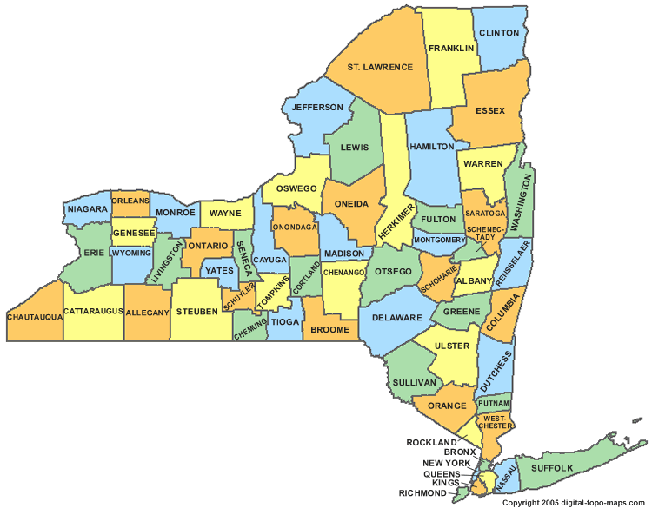
NY SOS SUPPORT COVERAGE
NEW YORK STATE
SOS SUPPORT COORDINATORS
Sue Walling
SOS (ACS) Ft Drum
(N)
(N)
Vacant
SOS (USAR) Rochester
(S)
(N)
(S)
(S)
Elise Fredette
SOS (NG) Latham
Cynthia Roberson- Vanlaningham
SOS (NG) Syracuse
Bonnie Morales
SOS (NG) NYC
Raul Lopez
SOS (ACS) West Point
Jacqueline Prince SOS (ACS) Ft Hamilton
214JunApr22001134

Slide 4
Life Insurance
Servicemember’s Group Life Insurance (SGLI)
SGLI after separation or retirement
State Servicemember’s Life Insurance (SSLI)
VA Life Insurance
Notes:
SGLI
What do you know about SGLI?
Covered 365 days a year, not just on drill as a reservist. Can elect up to $400,000 in $50,000 increments.
Prudential
Office of Servicemember’s Group Life Insurance (OSGLI)
Election Form: SGLV 8283; updated in the SOES system (See UA) **SGLI is given to whoever you elect as beneficiary. Will not be automatically given to PNOK.
When to update: sign at LEAST once a year (even if no changes are made); before a mobilization/deployment or school; any change in beneficiaries, coverage amounts, addresses or other information
FSGLI: Family SGLI; coverage for loss of spouse or child; automatically enrolled unless you decline coverage; Will see FSGLI on LES (child is free, will see spouse)
**Check your LES! Make sure your premiums are coming out!; should be $29 if elected $400K**
TSGLI: Traumatic SGLI; coverage for traumatic injury; premium included in SGLI premium ($1). Go to Unit in the event of this
What happens to SGLI after separation/retirement: SM is still covered for 120 days from date of separation or retirement. After that, SGLI drops off. SGLI can be converted into Veteran’s Group Life Insurance (VGLI) or a commercial policy. You have 1 year and 120 days from date of separation to apply. If you apply within 240 days you won’t need to answer any health questions. Any further information can be clarified with OSGLI.
SSLI
Free $1,000 insurance policy provided by the state
Paid our to NOK in order of law (spouse, children, parents…)
Can elect more (and pay premium) ***will allow you to elect any beneficiary you choose. Keep this info in a safe place***
Can take out SSLI for your dependents ***Keep this info in a safe place***
VA Life insurance
VA insurance program January 2023 for veterans with service connection
Guaranteed acceptance whole life insurance coverage to veterans age 80 and under with any level of service-connected disability. Some Veterans 81 and older may also be eligible.

Slide 5
Retirement/ Survivor Benefit Plan
Retirement Services Officer
20 year letter
Reserve Component Survivor Benefit Plan- election for benefits
Notes:
What happens to your retirement?
Get 20 year letter; If you do not make an election for SBP at the this time, it will default automatic spouse and child coverage. (SBP coverage will be deducted from retirement pay)
Options for SBP election are A: decline to make coverage until eligible to receive retired pay, B: elect coverage to begin at age 60, C: immediate SBP coverage
Beneficiary options: Spouses only, spouse and child, child only, insurable interest, former spouse, former spouse and dependent children from that marriage, NOT TO PARTICIPATE IN SBP
Think about what will best take care of your family if you died tomorrow.
Do you know that YOU have to apply for your retirement when you hit 60 years of age; it will not be automatically paid out when you turn 60
In the event of your death, your spouse also has to apply for SBP
Barring act: 6 year window to claim benefit
Retirement Services officer or SOSC can assist

Slide 6
Education Benefits
Transferability of Post 9/11 GI Bill
Who to contact concerning your benefits
Notes:
What happens to your unused education benefits in the event of your death?
Post 9/11 GI Bill allows service members to transfer unused education benefits to immediate family members (spouse and children)
Must have at least 6 years in and commit to additional 4 years to transfer
Can transfer to spouse and spouse can transfer to child(ren)
Info on your specific benefits: education POC for JFHQ (CPT Reynolds)
What happens if the person you transferred your education benefits to predeceases you?
*Unused portion can be transferred to others
Education POC can assist in how to transfer in milconnect

Slide 7
Estate Planning/ Wills
JAG
Civilian Attorneys
Notes:
What happens to the things that you own? (cars, bank accounts…)
JAG information; so you can begin to think of these things.
Civilian Attorney
Without a will/estate, family may have to go through Surrogate Court
“Payable upon death” can be added to bank accounts

Slide 8
Preparing for the future
Packets of important information/documents
Notes:
It is beneficial to put together a folder that you share with your family/who will be handling your affairs. As time goes on, things should be added to this folder.
Military documents (NGB 22, 20 Year Letter, DD214s)
VA documents (were you receiving any VA Disability Rating Papers)
SS Card/Numbers
Will/Estate/POA/HCP info
Marriage Certificates
Divorce Decrees
Birth Certificate
Adoption Papers/Guardianship
Technician documents if technician
TSP Documents
Car registrations/titles
Credit Card Statements/Credit Reports
Bank Account Information
Civilian Life Insurance Policies
Investment Portfolios or Statements
Tax Forms from Previous Years
SOSC information/MFH Information
For more specific information, the SOSC can assist in putting this together

Slide 9
Questions?

